Slide 1
Prototyping (and beyond)
Jarek Francik
CI7870 Game Science

Slide 2
So you have a game idea?
Ideas are cheap
Real challenge: communicate your idea

Slide 3
Communicate your Design
Decide upon an Experience: WHAT DO YOU WANT TO MAKE?
What are the goals: WHY ARE YOU MAKING THIS?

Slide 4
Communicate your design
GDD
Pitch
Prototype

Slide 5
GDD (Game Design Document)
Long GDD
10 pager
3 pager
1 pager

Slide 6
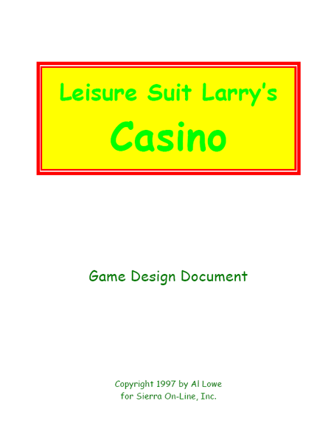
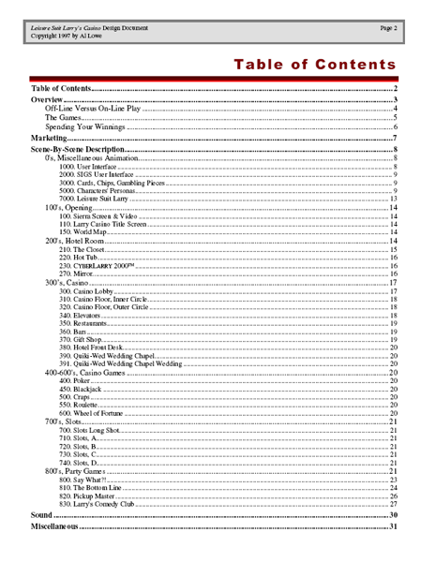
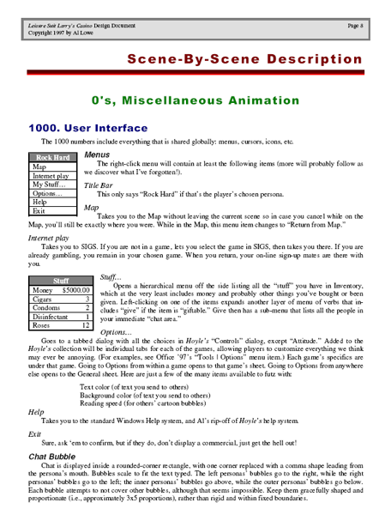
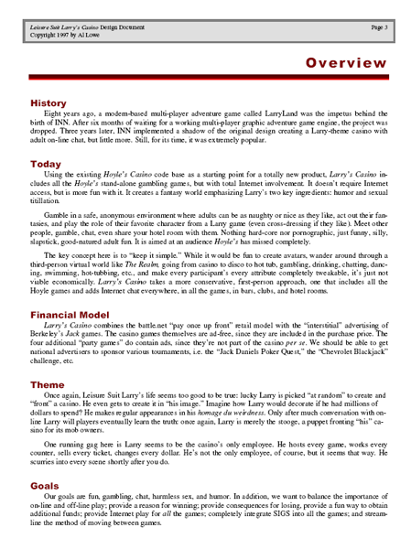
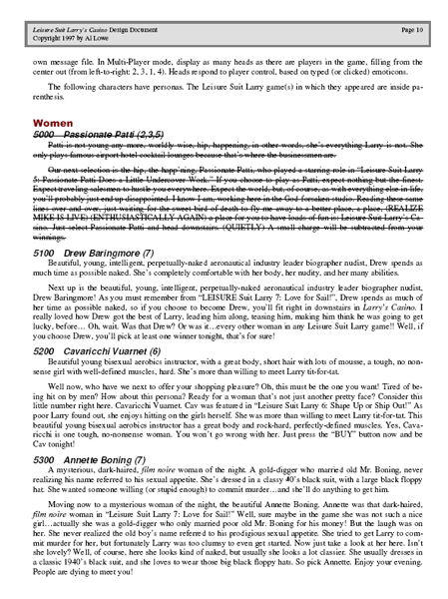

Slide 7
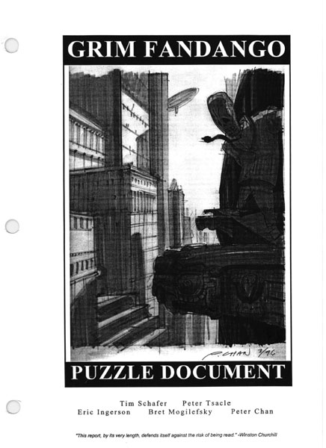
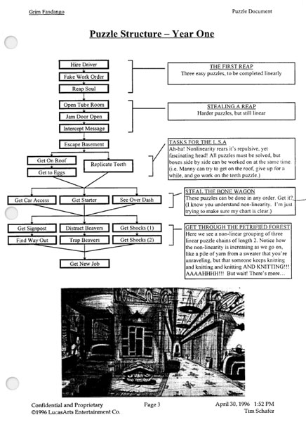
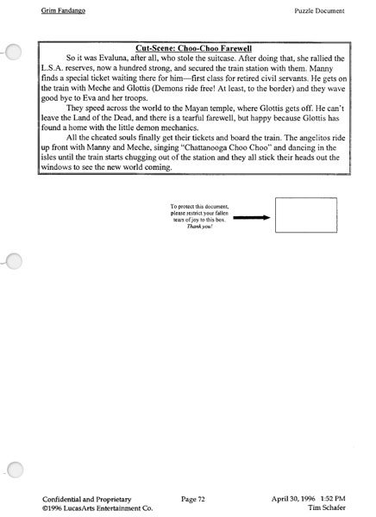
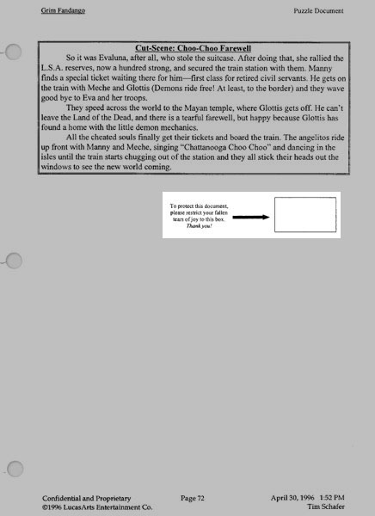
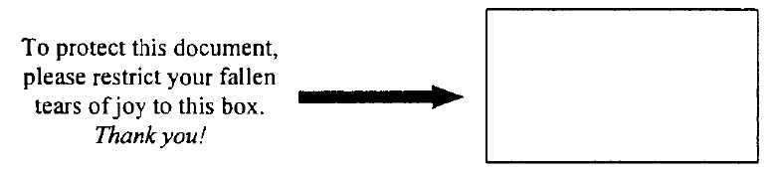

Slide 8
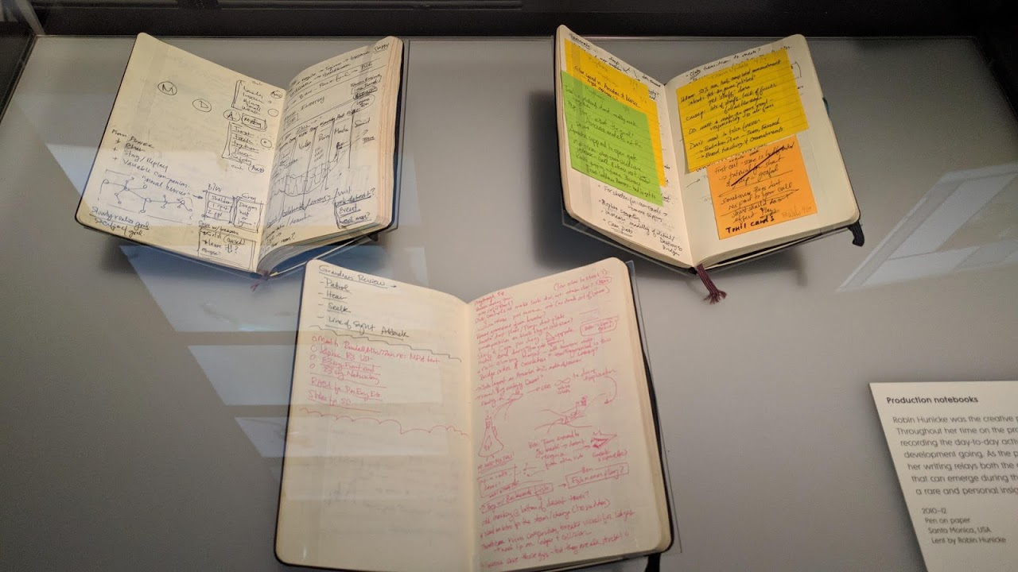
Not a GDD!
These are production notebooks from the game Journey
(developed by thatgamecompany, published by Sony Interactive Entertainment

Slide 9
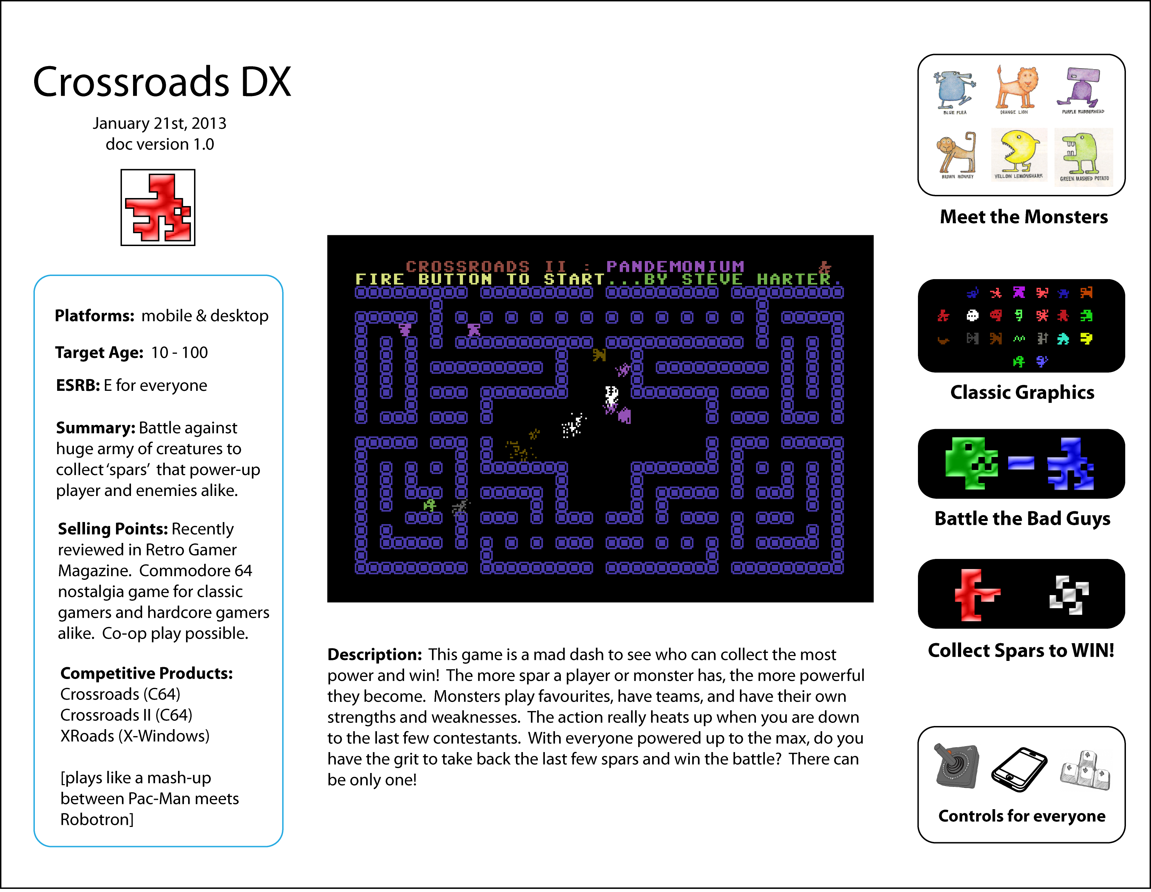

Slide 10
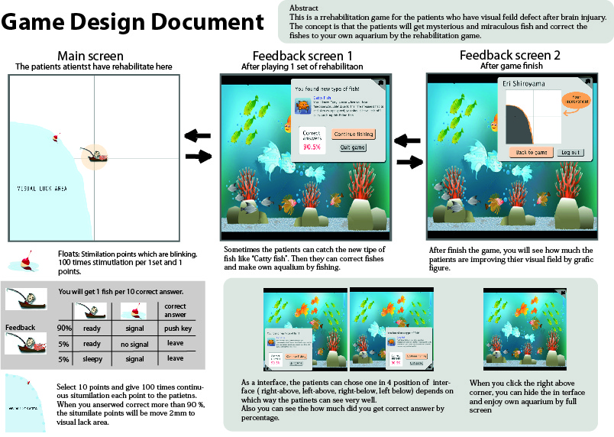

Slide 11
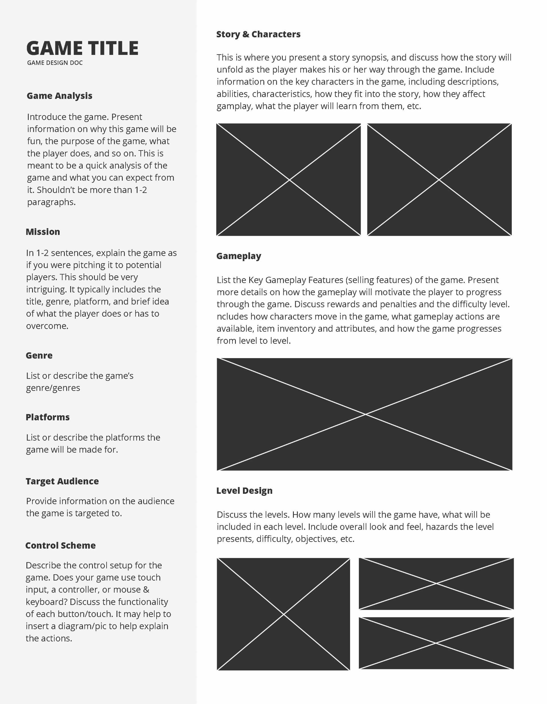

Slide 12
Homework
Create a 1-Pager for your project
Publish it in your blog
Bring a printout for the next session
This is a formative exercise

Slide 13
Game Pitch
Vision
Quick summary
Sell the idea!
Game Pillars
Mechanics should support your game pillars
Critical Success Factors
Feature goals
What can we not lose?
Reference
Picture paints a thousand words!
But a Prototype is even better!

Slide 14
Prototype
Decide what you want to prototype
Find a Theme
Work on Variations

Slide 15
Prototype a Design
Don’t Design a Prototype

Slide 16
Prototypes: Classification
Low Fidelity
Paper Prototypes
Clickable Prototypes
High Fidelity
Non-Playable
Playable

Slide 17
Prototypes: Classification
Vertical
Horizontal
…because games are like ogres

Slide 18
Prototypes: Classification
Vertical
Horizontal
audio assets
camera, lighting
art assets
play balancing
key gameplay mechanics
story
level 1
level 2
level 3
level 4
level 5
level 6

Slide 19
What kind of prototype would you use?
to explore new ideas or research alternatives?
to validate/balance game mechanics?
to demonstrate a game to a publisher?

Slide 20
What’s a difference?
Prototype
Demo / Trial
Trailer
Alphas, Betas, Release Candidates

Slide 21
What are you up to?
High fidelity playable prototype
Greybox Prototype:
ideal for testing mechanics concepts
useful for Level Design
great for illustration
Greybox does not have to be bleak!

Slide 22
What are you up to?
Unity as a rapid prototyping tool
ProBuilder
Snaps

Slide 23
What are you up to?
Prototyping:
Assets
Outdoor - Terrain
Buildings, Structures and Indoor
The character – 1st person
The character – 3rd person
NPC/AI

Slide 24
Credits
Kelvin Moore, Sumo Digital
Stone Librande, EA/Maxis
Games:
Leisure Suit Larry (Sierra Entertainment)
Grim Fandango (Tim Schafer et al. / LucasArts)
Journey (thatgamecompany / SIE)
Intermediate Game Design – Trinity University, San Antonio TX
https://vitalzigns.itch.io (1-Page GDD Template)
Shrek (DreamWorks)

